Slide 1
Short Introduction to Phylogenetics
Data Analysis in Genome Biology
GEN242
Thomas Girke
May 31, 2018

Slide 2
Outline
Introduction
Phylogenetics
Tree Basics
Tree Topology
Counting Trees
Tree Rooting Methods
Inferring Trees from Distances
Tree Building Methods
Clustering Methods
Parsimony Methods
Quality Assessment by Resampling
Bootstrap
Software
Extra Reading

Slide 3
Phylogeny: Evolutionary Relationships Among Organisms
Systematics is the study of the diversity of organisms. It often includes phylogenetics.
Phylogenetics is the study of the evolutionary relationships among organisms and their components.
Phylogenies (evolutionary models) provide a framework for studying evolutionary patterns and mechanisms.

Slide 4
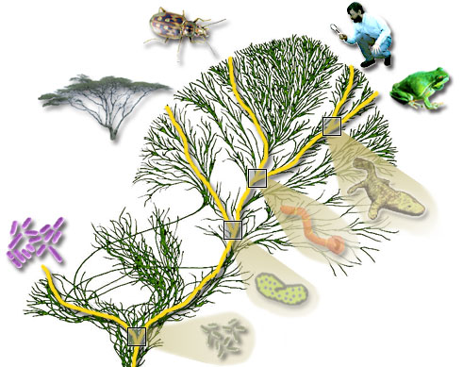
The Tree of Life
The similarity of molecular mechanisms suggests a common ancestor for all organisms.
Thus, any set of species is related. This relationship is called phylogeny.
Phylogenetic trees are often used to represent this relationship.

Slide 5
Sequence-Based Phylogenies
Traditionally, morphological characteristics from living and fossilised organisms have been used for inferring phylogenies.
Molecular relationships can provide more accurate distance measures, such as:
Immunological data
Mapping data
DNA and protein sequence data
Because certain sequences change with an almost constant rate over time they can serve as molecular clocks.
These clock-like sequences allow to infer often much more reliable phylogenies than traditional approaches.

Slide 6
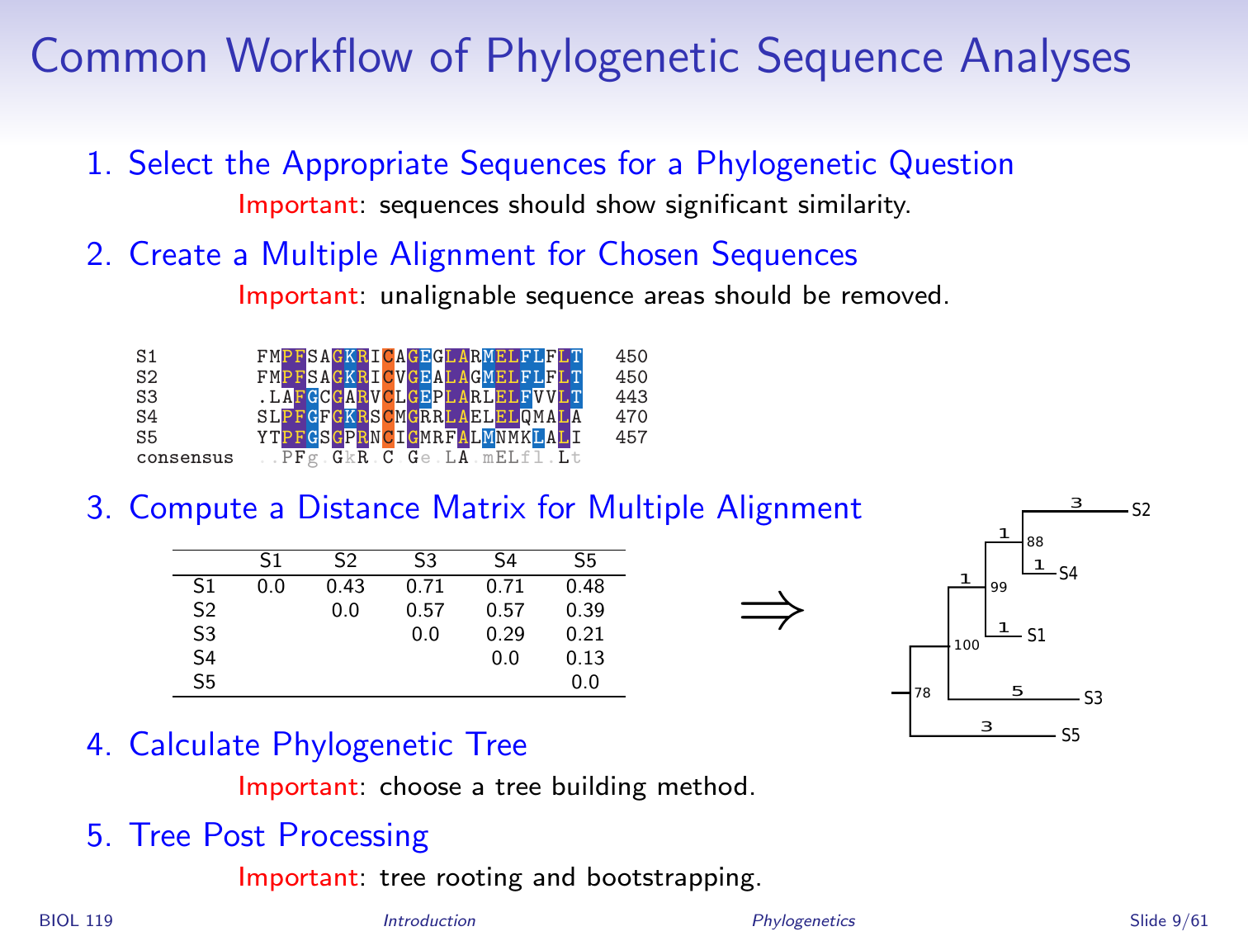
Common Workflow of Phylogenetic Sequence Analyses
Select the Appropriate Sequences for a Phylogenetic Question
Important: sequences should show significant similarity.
Create a Multiple Alignment for Chosen Sequences
Important: unalignable sequence areas should be removed.
Compute a Distance Matrix for Multiple Alignment
Calculate Phylogenetic Tree
Important: choose a tree building method.
Tree Post Processing
Important: tree rooting and bootstrapping.

Slide 7
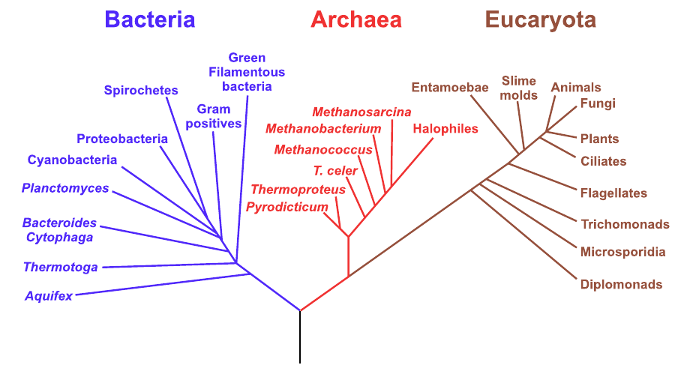
The Tree of Life
Phylogenies from sequences assume that they have evolved from the same ancestral gene in a common ancestral species.

Slide 8
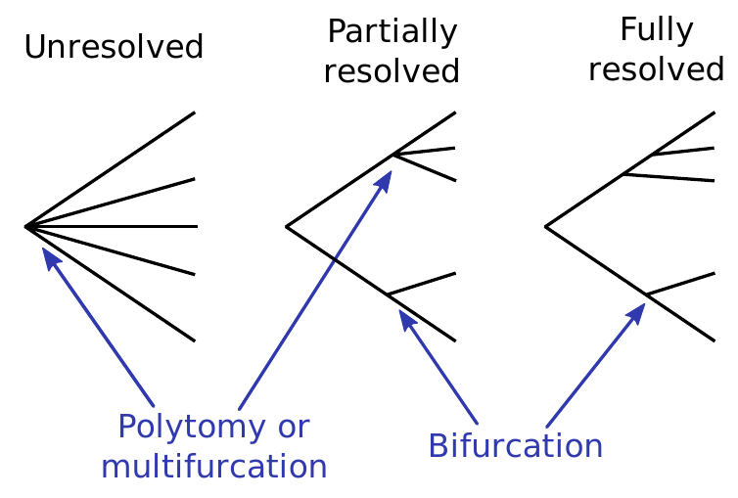
Incomplete Phylogenies of the Tree of Life
Some parts of the tree of life are fully resolved, others are only partially resolved or completely unresolved.

Slide 9
Evolution of Genes
Complication: the evolution of genes is driven by
Gene duplications
Gene losses
Speciation
Special case in bacteria: horizontal gene transfer

Slide 10
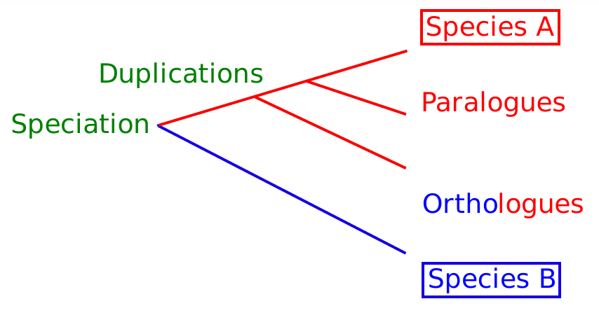
Orthologous and Paralogous Genes
Homologous genes: evolved from a common ancestor.
Orthologous genes: homologous genes that evolved by speciation.
Paralogous genes: homologous genes that evolved by gene duplications.
To infer phylogenies of species, orthologous genes need to be used.
To infer phylogenies of gene duplications, paralogous genes need to be used.

Slide 11
Outline
Introduction
Phylogenetics
Tree Basics
Tree Topology
Counting Trees
Tree Rooting Methods
Inferring Trees from Distances
Tree Building Methods
Clustering Methods
Parsimony Methods
Quality Assessment by Resampling
Bootstrap
Software
Extra Reading

Slide 12
Basics on Trees
Usually, the leaves (end nodes) of a tree are labelled.
In some cases the labels can be swapped without changing the tree.
A tree with a given leaf labelling is called a labelled branching pattern or the tree topology T.
The lengths of the edges are denoted by t_{i}

Slide 13
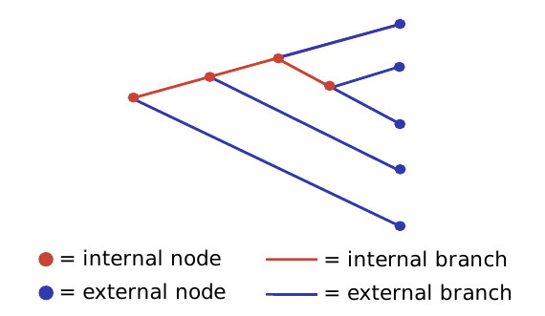
Basics on Trees
Typically, binary trees are used in phylogenetics, where three branches meet at each internal branch node.
Tree components
internal and external branches (edges)
internal and external nodes
A true phylogeny has a root, which represents the ultimate ancestor for all the other items in a tree.
Certain algorithms like parsimony or probabilistic models provide no information about the position of the root in a tree.

Slide 14
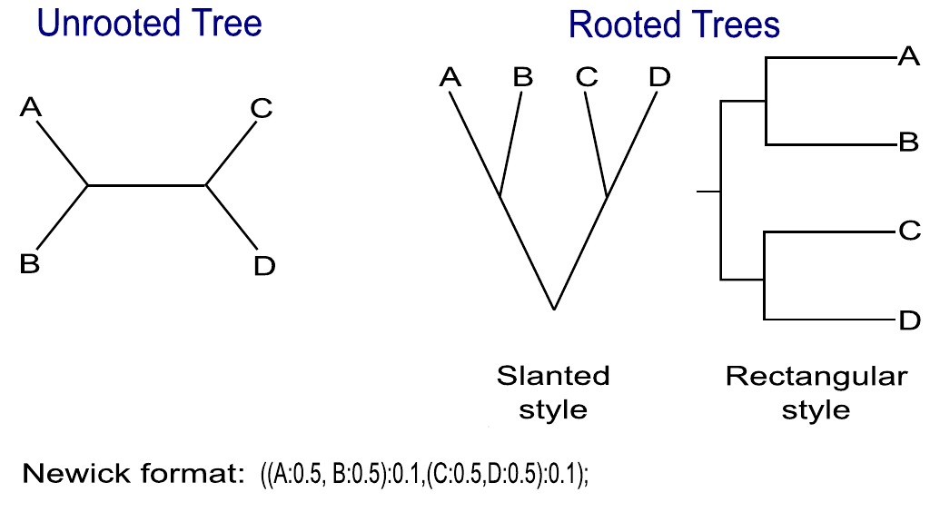
Tree Styles

Slide 15
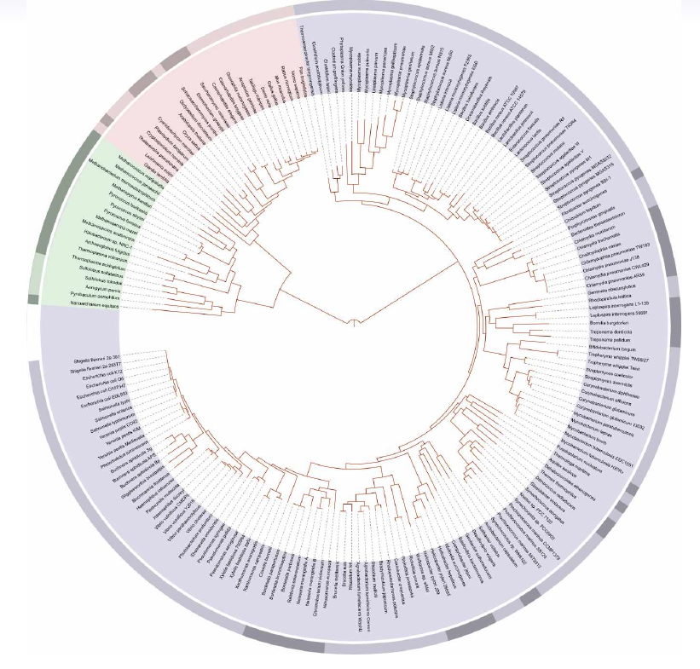
Tree Styles: Circle Tree
Circle tree

Slide 16
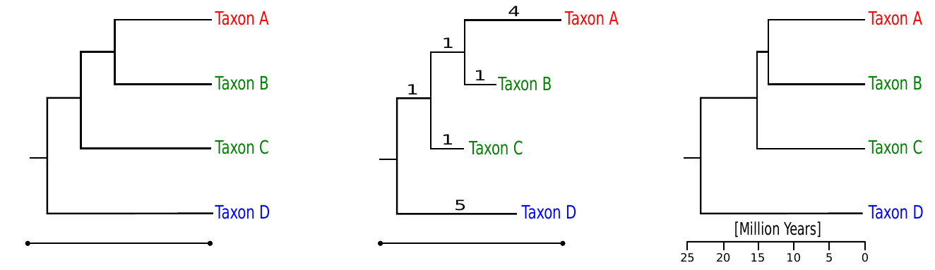
Significance of Branch Lengths in Trees
Cladogram
Phylogram
Ultrametric Tree
Branch lengths have no meaning.
Branch lengths are proportional to (genetic) change.
Branch lengths are proportional to time.

Slide 17
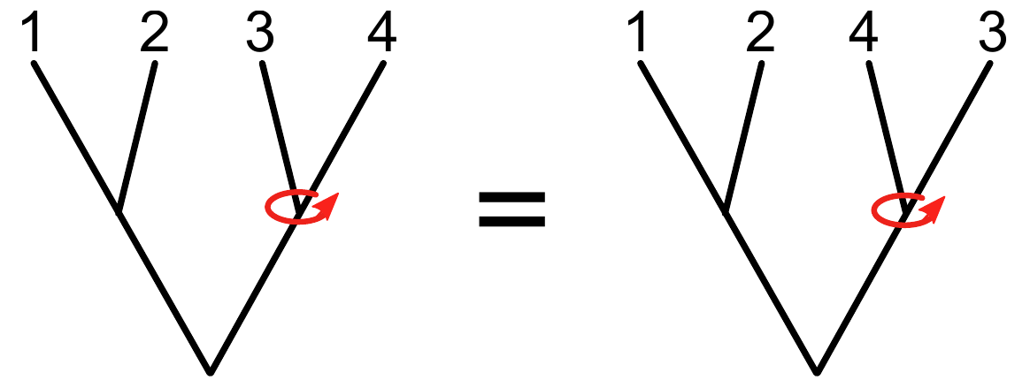
Rotating Branches in Phylogenetic Trees
Rotations of internal nodes yield exactly the same tree.

Slide 18
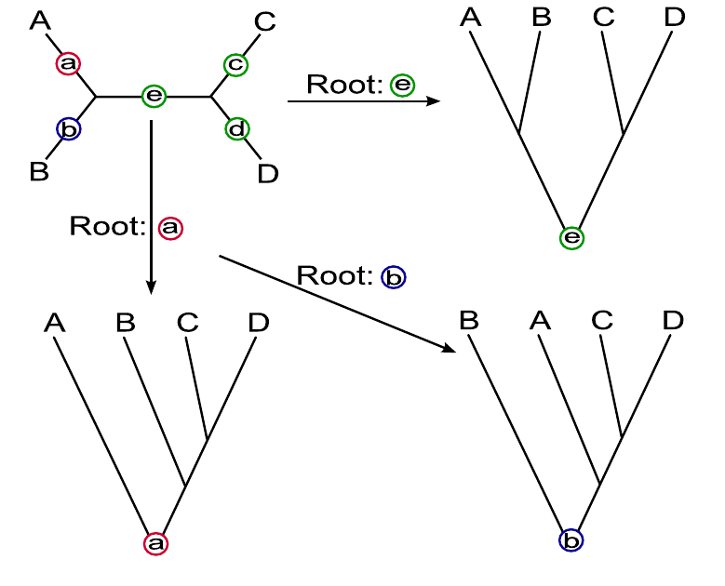
Rooting Trees
There are five possibilities to root the unrooted tree on the top left.
Trees rooted on branches c and d are not shown.

Slide 19
Outline
Introduction
Phylogenetics
Tree Basics
Tree Topology
Counting Trees
Tree Rooting Methods
Inferring Trees from Distances
Tree Building Methods
Clustering Methods
Parsimony Methods
Quality Assessment by Resampling
Bootstrap
Software
Extra Reading

Slide 20
Number of Nodes and Branches in Trees
N nodes in rooted tree = (2n − 1)
N branches in rooted tree = (2n − 2)
N nodes in unrooted tree = (2n − 2)
N branches in unrooted tree = (2n − 3)
n = number of leaves (taxa)

Slide 21
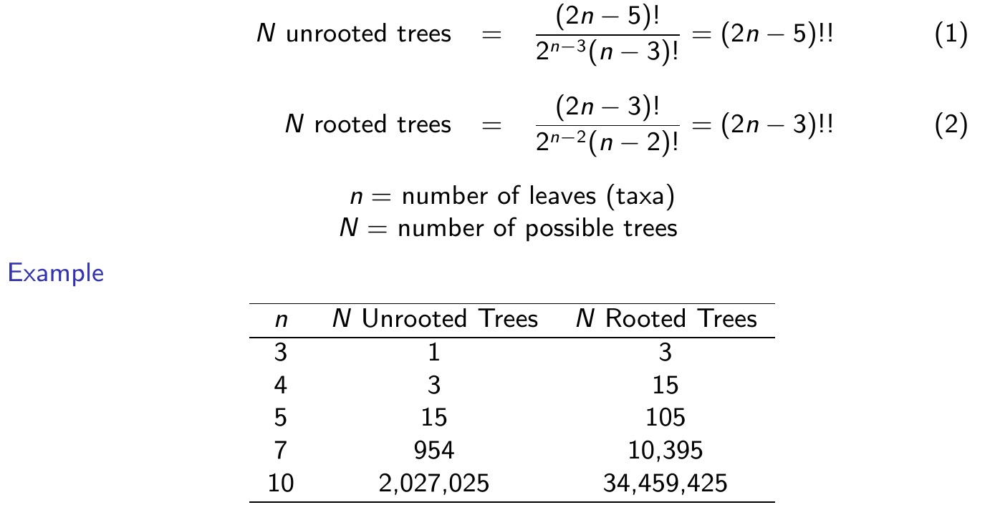
Number of Unrooted and Rooted Trees
The number of possible trees grows more than exponentially as the number of taxa n increases:

Slide 22
Outline
Introduction
Phylogenetics
Tree Basics
Tree Topology
Counting Trees
Tree Rooting Methods
Inferring Trees from Distances
Tree Building Methods
Clustering Methods
Parsimony Methods
Quality Assessment by Resampling
Bootstrap
Software
Extra Reading

Slide 23
Methods for Rooting Phylogenetic Trees
Outgroup Method
Rooting by including one or more outgroup taxa/sequences.
Gene Duplication
Paralogous gene duplication predating the common ancestor of a clade are used.
Midpoint Rooting
Tree is rooted by midpoint between the two most distant branches.

Slide 24
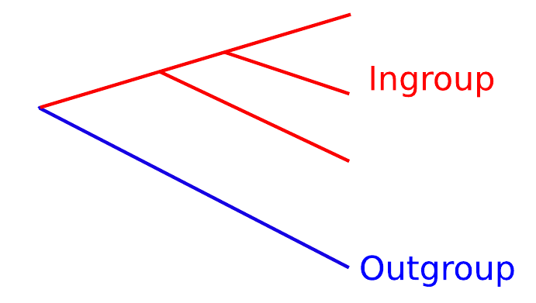
Rooting by Outgroup
Rooting is accomplished by including one or more outgroup (taxa/sequences) that differ from all ingroup members more than all the ingroup members among each other.
The main assumption of this method is that outgroup taxa fall outside of the ingroup.

Slide 25
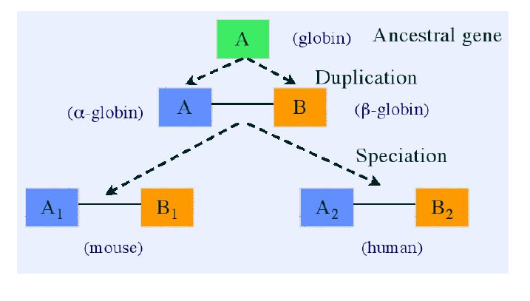
Rooting with Duplicated Genes
A gene duplication in an ancestral organism gives rise to paralogous genes.
Speciation processes give rise to orthologous genes.

Slide 26
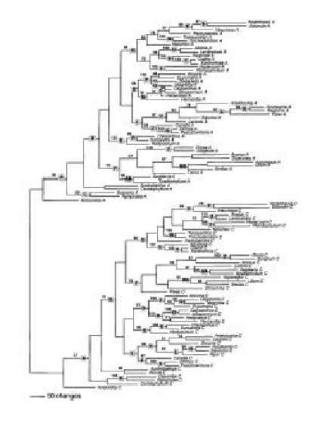
Rooting with Duplicated Genes
The root is placed between paralogous gene populations.
Gene Copies A
Gene Copies B

Slide 27
Rooting the Tree of Life
Cenancestor
Universal trees based on single gene orthologs cannot be rooted by the outgroup method, because of the lack of an ancestral sequence.
Solution: use ancient gene duplication that predates the last common ancestor (cenancestor) of all living organisms Iwabe et al. (1989).

Slide 28
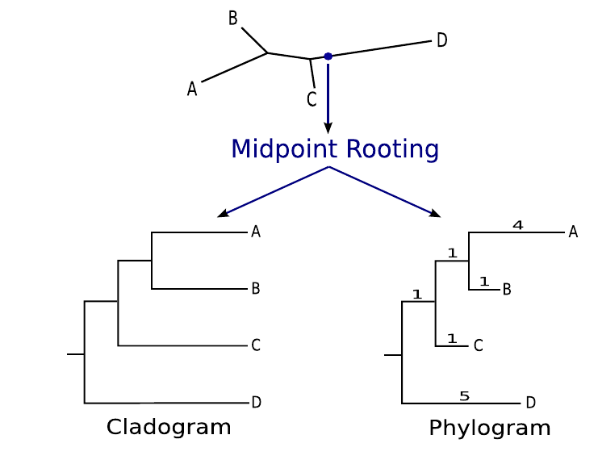
Midpoint Rooting
Choose the midpoint between the two most distant branches.
Midpoint rooting assumes that the rate of evolution is the same on the longest branches of the tree.

Slide 29
Outline
Introduction
Phylogenetics
Tree Basics
Tree Topology
Counting Trees
Tree Rooting Methods
Inferring Trees from Distances
Tree Building Methods
Clustering Methods
Parsimony Methods
Quality Assessment by Resampling
Bootstrap
Software
Extra Reading

Slide 30
Transforming Aligned Sequences to Distances
DNA Alignment
G1 TTATTAA
G2 AATTTAA
G3 AAAAATA
G4 AAAAAAT
Distance Matrix
Absolute distances in bottom triangle and uncorrected relative distances in top triangle.
 | G1 | G2 | G3 | G4
G1 |  | 0.43 | 0.71 | 0.71
G2 | 3 |  | 0.57 | 0.57
G3 | 5 | 4 |  | 0.29
G4 | 5 | 4 | 2

Slide 31
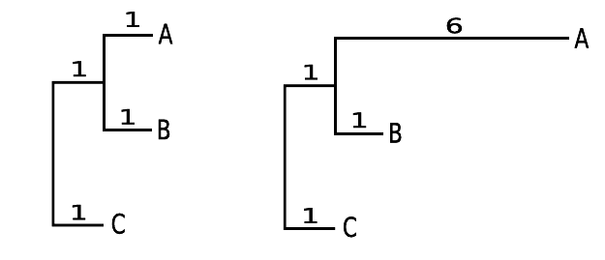
Similarity vs. Phylogenetic Relationship
Similarity and phylogenetic relationships are not the same.
Similarity refers to likeness or resemblance.
Phylogenetic relationship refers to historical connections through common ancestry.
Similarity: evolutionary relationship when distances are ultrametric (e.g. sequences are evolving in a perfectly clock-like manner).
Example Tree A: B is most similar to A and is also most closely related to A.
When distances are not ultrametric, two taxa can be most similar without being closely related.
Example Tree B: B is more similar to C, but it is most closely related to A.
Tree A Tree B

Slide 32
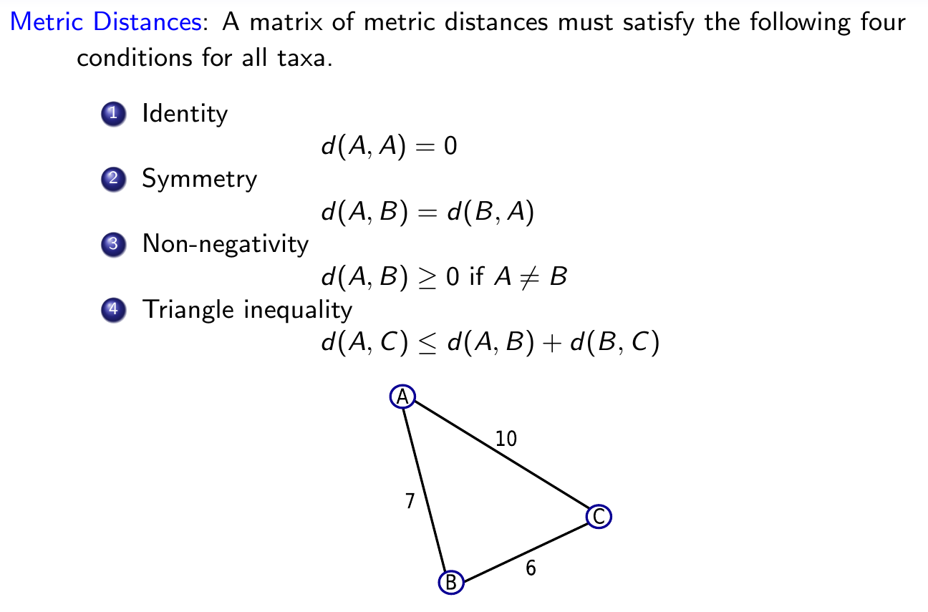
Properties of Distances

Slide 33
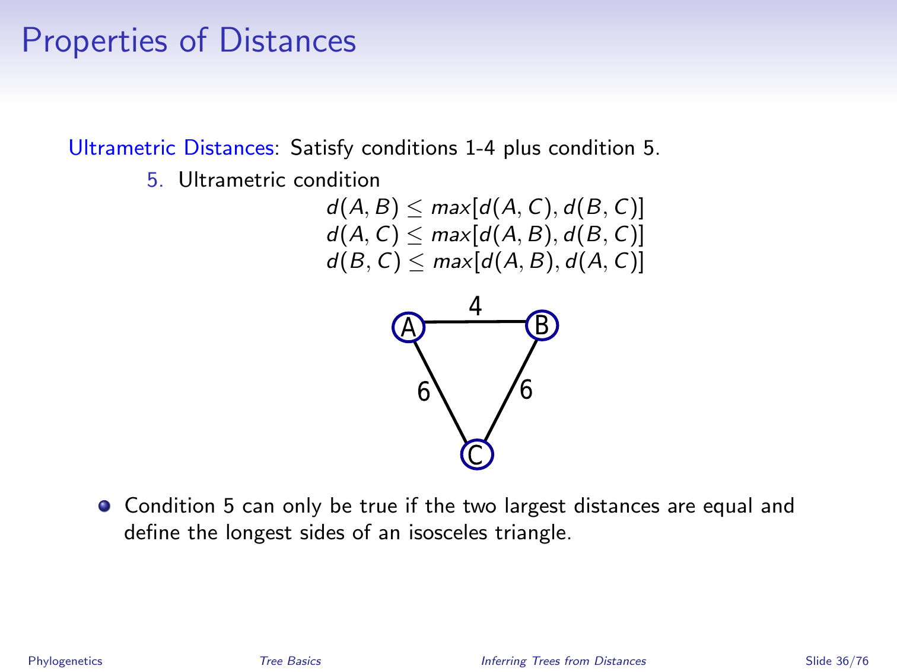
Properties of Distances

Slide 34
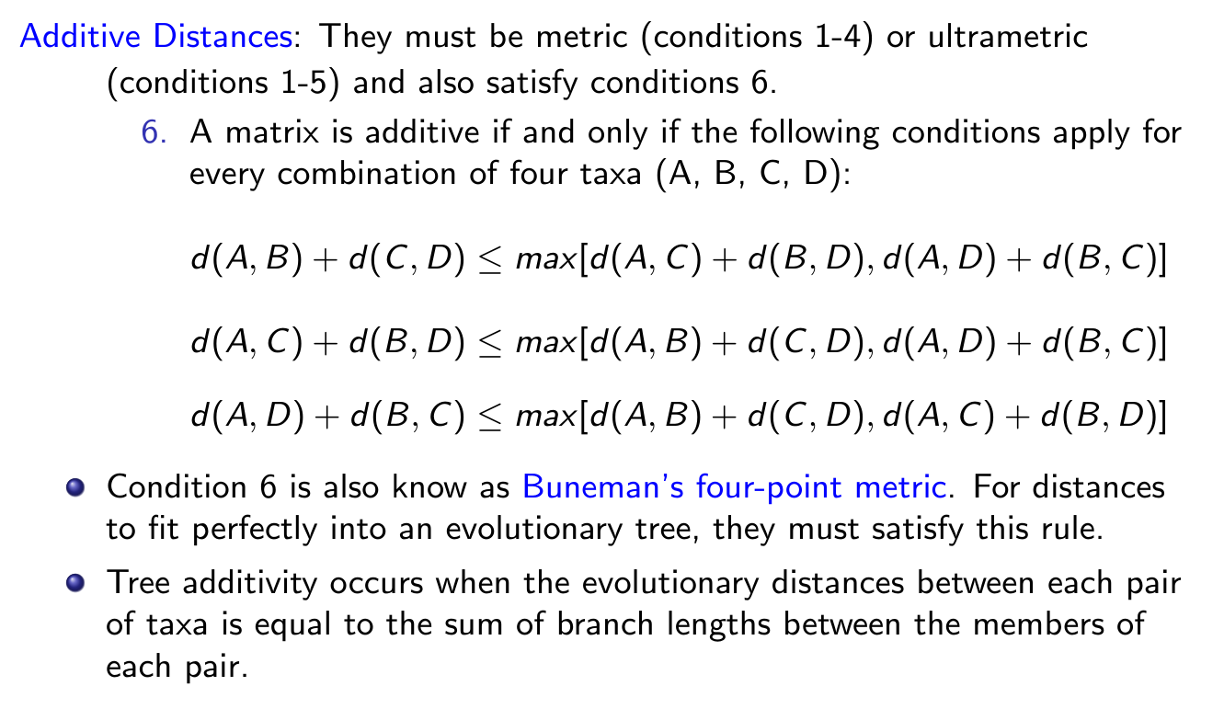
Properties of Distances

Slide 35
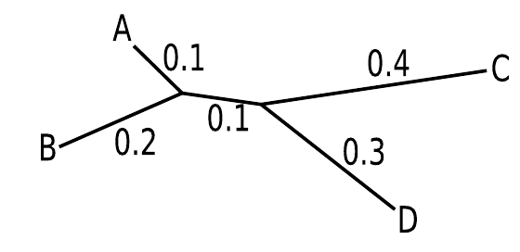
Additivity of Distances in Trees
Additive property: the distances in the distance matrix match the relative branch lengths in the tree.
In a perfectly additive tree the branch lengths match the distances in the distance matrix perfectly. In such a case there will be only a single and unique additive tree that fits the distance matrix (perfect fit theorem).
Example for perfectly additive tree:
 | B | C | D
A | 0.3 | 0.6 | 0.5
B |  | 0.7 | 0.6
C |  |  | 0.7

Slide 36
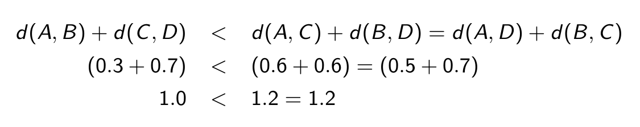
Application of Buneman’s Test
The Buneman’s four-point metric simply means that of the three sums of distances, one sum must be smaller than the other two, and these other two must be equal.
For example:

Slide 37
Neighbor-Relations Methods
The neighbor-relations method takes advantage of the Buneman’s four-point metric to choose the correct tree when the distances are additive.
Neighbors are taxa that are joined through a single internal node. Non-neighbors are joined through more than one internal node.
If the tree above is taken as the true tree, then d(A, B) + d(C, D) < d(A, C) + d(B, D) = d(A, D) + d(B, C), because d(A, B) and d(C, D) are distances between neighbors and do not contain the internal branch.
In the case of four taxa with unknown phylogenetic relationships, identify the two sets of neighbors. Once the neighbors are identified, so is the topology.

Slide 38
Neighbor-Relations Methods
With four taxa three unrooted trees are possible.
Each tree contains different neighbors.
To determine which taxa are neighbors, compute the distances for all possible pairs of taxa.
The given tree is the correct one, because the sum d(A, B) + d(C, D) is the smallest of the three possible sums.
 | B | C | D
A | 0.3 | 0.6 | 0.5
B |  | 0.7 | 0.6
C |  |  | 0.7

Slide 39
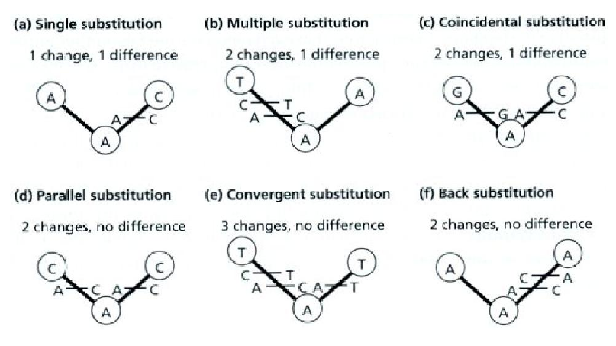
Superimposed Substitutions Cause Distances to Be Non-Additive
Complete inventory of all genetic events (unique and superimposed substitutions) would constitute a set of perfectly additive distances.
However, superimposed substitutions cause observed distances to be non-additive and underestimate true evolutionary distances.

Slide 40
Correction for Non-Additive Distances
Models of sequence evolution are employed to correct observed distances for superimposed substitutions.
Ideally, this will result in additive distances.
In reality, corrected distances are unlikely to exhibit a perfect fit to path length distances on a tree because of:
Inadequate models of sequence evolution.
Stochastic (random) error associated with sequences of finite length.

Slide 41
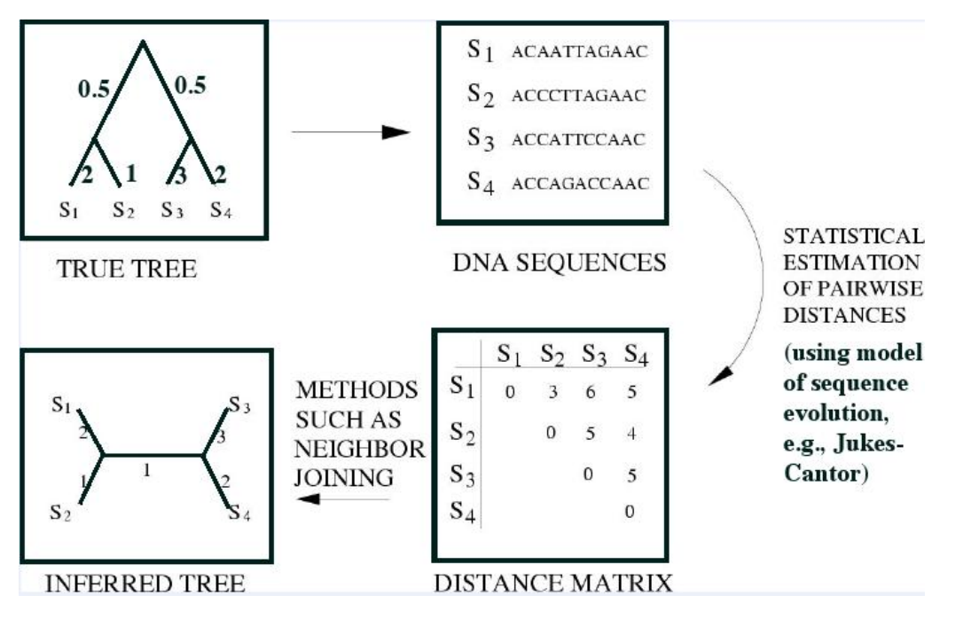
Additivity and Distance Matrices

Slide 42
Outline
Introduction
Phylogenetics
Tree Basics
Tree Topology
Counting Trees
Tree Rooting Methods
Inferring Trees from Distances
Tree Building Methods
Clustering Methods
Parsimony Methods
Quality Assessment by Resampling
Bootstrap
Software
Extra Reading

Slide 43
Desirable Features of Tree Building Methods
Consistency: will the method converge on the correct solution given enough data?
Efficiency: how fast is the method?
Robustness: will minor violations of the assumptions result in poor estimates of phylogeny?

Slide 44
Clustering Methods
Algorithmic methods in which the algorithm itself defines the tree selection criterion.
No optimality criteria applied.
Advantage: tend to be very fast (efficient) computations that produce singular trees.
Disadvantages:
Do not allow evaluation of competing hypotheses.
No objective function (e.g. likelihood, number of steps) is used to compare different trees to each other, even if numerous other trees could explain the data equally well.
Examples that construct trees from distances:
UPGMA
Neighbor joining (NJ)

Slide 45
UPGMA
UPGMA stands for unweighted pair group method using arithmetic averages (Sokal and Michener, 1958).
Clusters taxa (sequences) agglomeratively and creates at the same time a hierarchical tree.
The branch (edge) lengths and node positions are determined by the average distance between clusters.
There are variants of UPGMA that define the distance between clusters (linkage method) as the minimum or maximum of the distances between clusters, rather than the average.
The average linkage seems to have the best performance.

Slide 46
UPGMA Algorithm
Initialization
Assign each sequence to its own cluster.
Iteration
Determine the clusters with the smallest distance (d). If there are several equidistant choices then pick one randomly.
Join these closest clusters to a new (larger) cluster.
Place a node for new cluster at the height corresponding to half of the distance between the joined clusters.
Update distances by computing the distance of the new cluster to all other clusters.
Termination
When only two clusters remain place the root at the height corresponding to half of their distance.

Slide 47
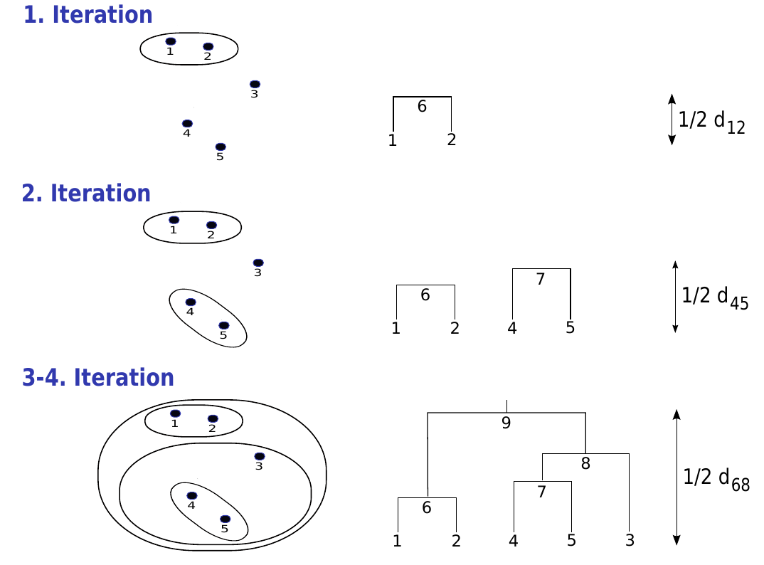
Illustration of UPGMA Algorithm

Slide 48
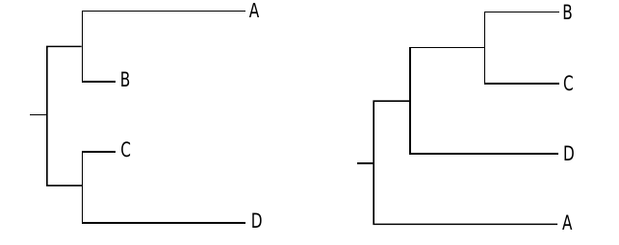
Limitations of UPGMA Algorithm
The edge lengths of an UPGMA tree correspond roughly to the times measured by a molecular clock with constant rate.
The method assumes that the divergence of sequences occurs at all points in the tree with a constant rate and the distances are additive.
If the molecular clock assumption applies to a given distance matrix, then UPGMA constructs the tree correctly.
However, if this assumption does not apply to the underlying distance matrix, then UPGMA may construct the tree incorrectly.
Example: correct tree on the left and incorrect UPGMA tree on the right:
Solution: test if the distance matrix is ultrametric, where in any triplet of distances one pair must be equal and the remaining one is the smallest.

Slide 49
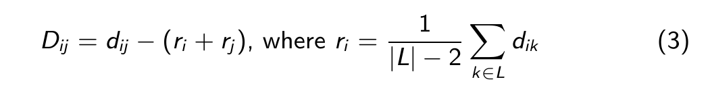
Neighbor-Joining Method
If the molecular clock property fails for a given data set, but additivity holds, then the neighbor-joining method can construct a correct tree.
To overcome the problem that neighboring leaves can be more distant to each other than to non-neighboring leaves (see previous slide), one can calculate the rate corrected distances D_{ij} by subtracting from d_{ij} the averaged distances to all other leaves:
|L| is the size of the leaf set L.
Consequence: i and j are neighboring leaves if their D_{ij} is minimal!

Slide 50
Example: Rate Corrected Distance Matrix
Distance Matrix
Upper right triangle: original distance values.
Lower left triangle: rate corrected distances calculated by equation (3) as:
r_{A} = (0.3 + 0.7 + 0.4)/2 = 0.7
r_{B} = (0.3 + 0.8 + 0.5)/2 = 0.8
r_{C} = (0.7 + 0.8 + 0.5)/2 = 1.0
...
D_{AB} = 0.3 − 0.7 − 0.8 = −1.2
D_{AC} = 0.7 − 0.7 − 1.0 = −1.0
 | A | B | C | D
A |  | 0.3 | 0.7 | 0.4
B | -1.2 |  | 0.8 | 0.5
C | -1.0 | -1.0 |  | 0.5
D | -1.0 | -1.0 | -1.2

Slide 51
Main Differences Between UPGMA and Neighbor-Joining
UPGMA
Assumes additivity and ultrametricity.
Does not use rate corrected distances values for tree construction.
Results in a rooted tree with branch pairs reflecting the distance information.
Tree type: cladogram.
May fail to generate the correct tree from distance values that violate the ultrametricity rule.
Neighbor-Joining
Assumes additivity, but not ultrametricity.
Uses rate corrected distances values for tree construction.
Results in an unrooted tree with the branch lengths reflecting the distance information.
Tree type (after rooting): phylogram or cladogram.
Generates correct tree from distance values that may violate the ultrametricity rule.

Slide 52
Outline
Introduction
Phylogenetics
Tree Basics
Tree Topology
Counting Trees
Tree Rooting Methods
Inferring Trees from Distances
Tree Building Methods
Clustering Methods
Parsimony Methods
Quality Assessment by Resampling
Bootstrap
Software
Extra Reading

Slide 53
Parsimony
Basic principle: find the tree that explains the observed sequences with the minimal number of substitutions.
Instead of building a tree, like with distance methods, parsimony assigns a cost to a given tree.
This requires searching through all possible trees or a subset of trees that contains the best or close to best tree topology.
Parsimony algorithms consist of two major steps:
Computation of the cost for a given tree
Search for the tree with minimum cost

Slide 54
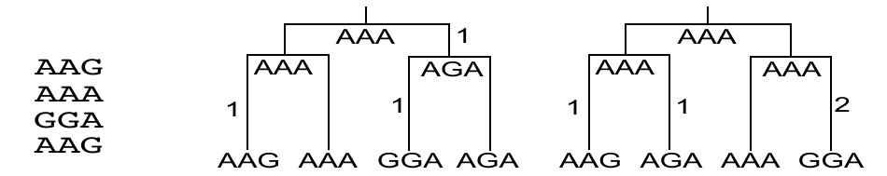
Example: Computing the Cost of a Given Tree
Given a multiple alignment and a tree topology, one can count the number of substitution needed for each tree.
The following figure shows two possible trees for the alignment on the left. Trees differ in the order the sequences are assigned to the leaves.
Hypothetical sequences have been assigned to the ancestral nodes that minimize the number of substitution needed in the entire tree.
Alignment Two Possible Parsimony Trees
The tree on the left is more parsimonious than the one on the right because it requires only 3 instead of 4 changes.
As shown here, parsimony treats each site independently and then sums up the substitutions needed for all sites.

Slide 55
Tree Search Methods
Several tree search methods can be considered:
Exhaustive Searches: All trees are evaluated only possible for trees with less than 20 taxa.
Heuristic Searches: Not guaranteed to find the best tree (e.g. random branch changes and re-scoring of tree).
Branch and bound algorithm which does not evaluate all trees, but guarantees to find the best tree.
Many other approaches.
Branch and bound algorithm
It exploits the idea that the cost (number of substitutions) of a subtree can only increase by adding an extra edge.
It systematically builds trees with increasing numbers of leaves and abandons avenues of tree building whenever an incomplete tree exceeds the smallest cost of a complete tree.

Slide 56
Outline
Introduction
Phylogenetics
Tree Basics
Tree Topology
Counting Trees
Tree Rooting Methods
Inferring Trees from Distances
Tree Building Methods
Clustering Methods
Parsimony Methods
Quality Assessment by Resampling
Bootstrap
Software
Extra Reading

Slide 57
Assessing the Reliability of Tree Branches
Nonparametric resampling methods are often used to estimate the variance associated with a statistic when the underlying sampling distribution for a statistic is either unknown or difficult to derive analytically.
Resampling methods include the bootstrap and the jackknife, both of which operate by repeatedly resampling data from the original data set to estimate the variance of the sampling distribution.
Although both methods have been used for evaluating the reliability of branches, the bootstrap method is more commonly applied.

Slide 58
Bootstrap Resampling
Data points are randomly resampled from the original data set, with replacement, until new data sets with the original number of observations are obtained.
Statistic of interest (e.g. a tree) is computed for each replicated data set.
Agreement among the resulting trees is summarized with a majority-rule consensus tree (agreement > 50%).
A bootstrap proportion (BP) is the frequency of occurrence of a clade (for all replicated data sets) and is a measure of support for a group.

Slide 59
Example: Bootstrapping
[A] Original multiple alignment (MSA)
[B] Resampling of MSA (example)
 | 1 | 2 | 3 | 4 | 5 | 6 | 7 | 8
A | C | C | S | S | S | S | S | S
B | C | C | P | P | P | P | P | P
C | C | C | C | C | C | P | P | P
D | P | P | C | C | C | C | C | C
Outgroup | C | C | C | C | C | C | C | C
 | 1 | 2 | 2 | 4 | 4 | 6 | 6 | 8
A | C | C | C | S | S | S | S | S
B | C | C | C | P | P | P | P | P
C | C | C | C | C | C | P | P | P
D | P | P | P | C | C | C | C | C
Outgroup | C | C | C | C | C | C | C | C
[B] Resampling of MSA (continued)
[C] Majority rule tree with bootstrap proportions (BP) at branch nodes
Compute 100, 1000 or more resampled MSAs
Compute for original MSA and each resampled MSAs a tree
Determine how often each clade (sub-cluster) in original tree occurs in trees of resampled MSAs according to a majority rule.
Frequencies/percentages are reported as bootstrap values at corresponding tree branches.
A
B
C
D
94%
65%
Outgroup

Slide 60
Interpreting Bootstrap Values
Bootstrap proportions are sometimes interpreted as confidence intervals for phylogenies.
This interpretation assumes that characters (e.g. nucleotide or amino acid sites) are independent and identically distributed, and that the method is consistent.
Even in a best case scenario bootstrapping sometimes gives underestimates of accuracy at high bootstrap values and overestimates of accuracy at low bootstrap values.

Slide 61
Outline
Introduction
Phylogenetics
Tree Basics
Tree Topology
Counting Trees
Tree Rooting Methods
Inferring Trees from Distances
Tree Building Methods
Clustering Methods
Parsimony Methods
Quality Assessment by Resampling
Bootstrap
Software
Extra Reading

Slide 62
Phylogenetics Software (Selection!)
PAUP: complex phylogenetic tool collection (partially commercial)
PHYLIP: complex phylogenetic tool collection (free)
MrBayes: popular package for Bayesian inference of phylogenies.
PAML: many utilities for dealing with different evolutionary rates.
Many more: see for instance this Link Collection.

Slide 63
References
Bos, K. I., Schuenemann, V. J., Golding, G. B., Burbano, H. A., Waglechner, N., Coombes, B. K., McPhee, J. B., DeWitte, S. N., Meyer, M., Schmedes, S., Wood, J., Earn, D. J., Herring, D. A., Bauer, P., Poinar, H. N., Krause, J., Oct 2011. A draft genome of Yersinia pestis from victims of the Black Death. Nature 478 (7370), 506–510. URL http://www.ncbi.nlm.nih.gov/pubmed/21993626
Felsenstein, J., 2004. Inferring phylogenies. Vol. 2. Sinauer Associates Sunderland.
Iwabe, N., Kuma, K., Hasegawa, M., Osawa, S., Miyata, T., Dec 1989. Evolutionary relationship of archaebacteria, eubacteria, and eukaryotes inferred from phylogenetic trees of duplicated genes. Proc Natl Acad Sci U S A 86 (23), 9355–9359. URL http://www.hubmed.org/display.cgi?uids=2531898
Sokal, R. R., Michener, C. D., 1958. A statistical method for evaluating systematic relationships. University of Kansas.

